Slide 1


Virtualization
technologies
Part 2
DevOps Spring 2017

Slide 2
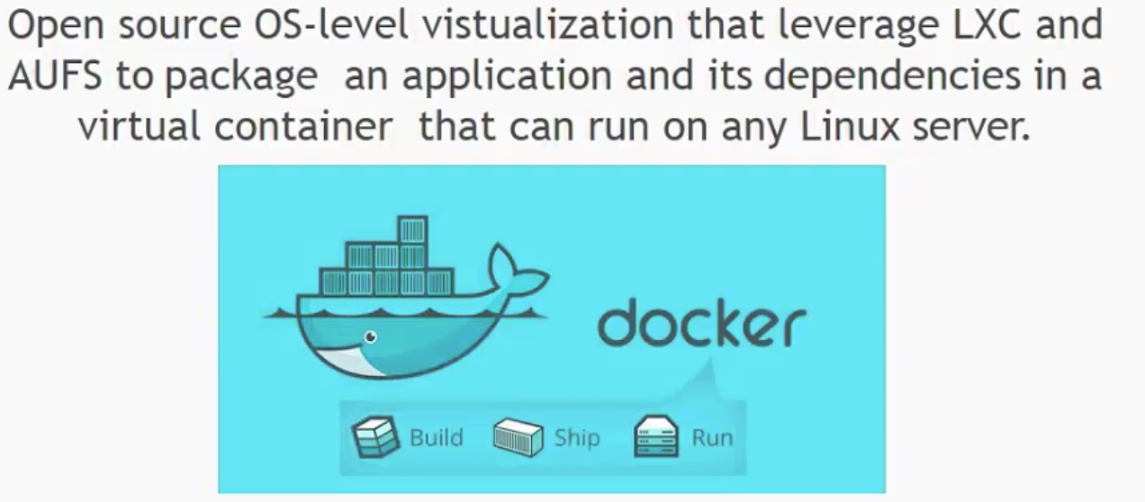
What is docker?

Slide 3
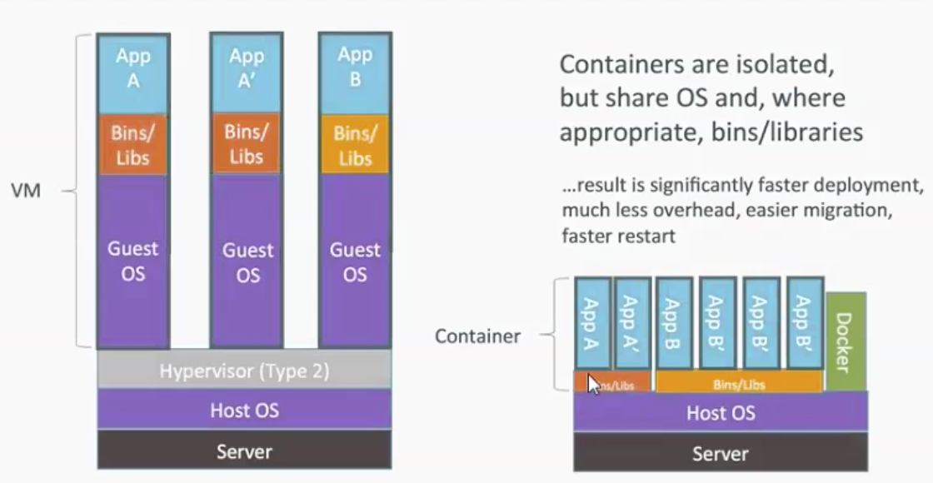
In brief

Slide 4
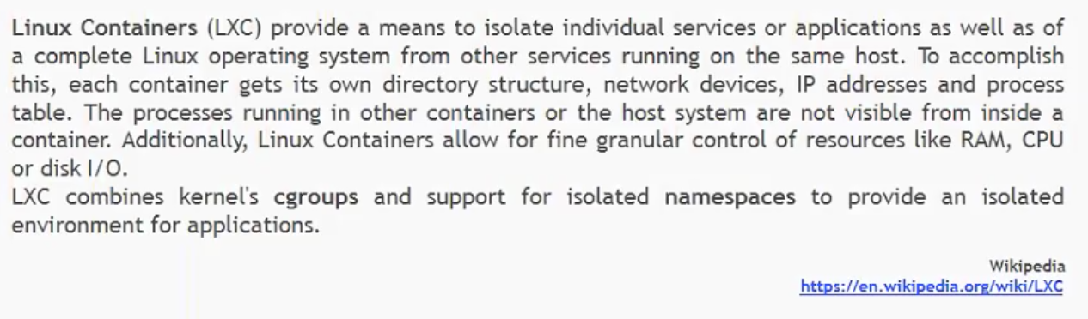
LXC
Goolge – Linux contaainers

Slide 5
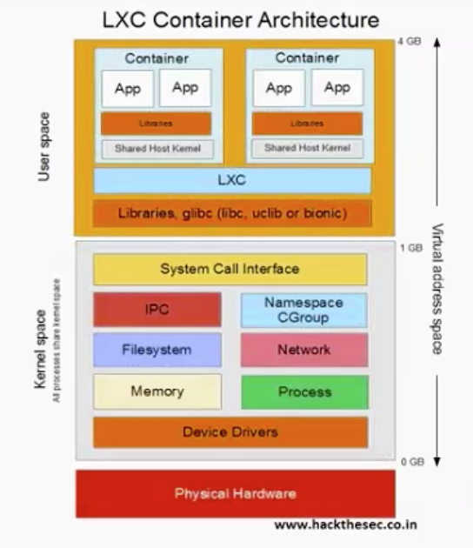
LXC

Slide 6
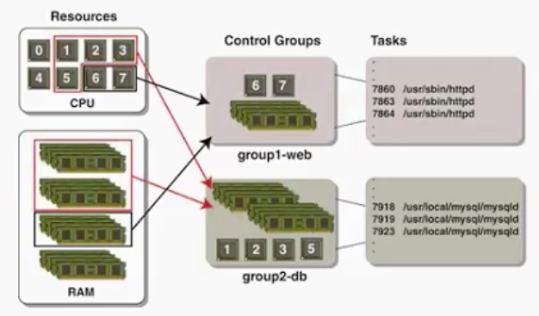
CGroups
cgroups (abbreviated from control groups) is a Linux kernel feature that limits, accounts for, and isolates the resource usage (CPU, memory, disk I/O, network, etc.) of a collection of processes.

Slide 7
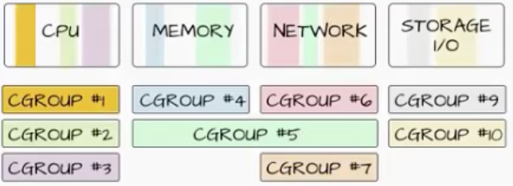
Cgroups
Resource limiting – groups can be set to not exceed a configured memory limit, which also includes the file system cache^{[8][9]}
Prioritization – some groups may get a larger share of CPU utilization^{[10]} or disk I/O throughput^{[11]}
Accounting – measures a group's resource usage, which may be used, for example, for billing purposes^{[12]}
Control – freezing groups of processes, their checkpointing and restarting^{[12]}

Slide 8
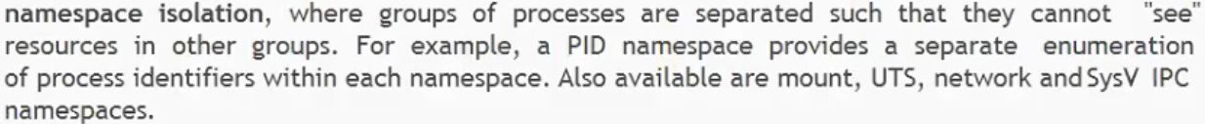
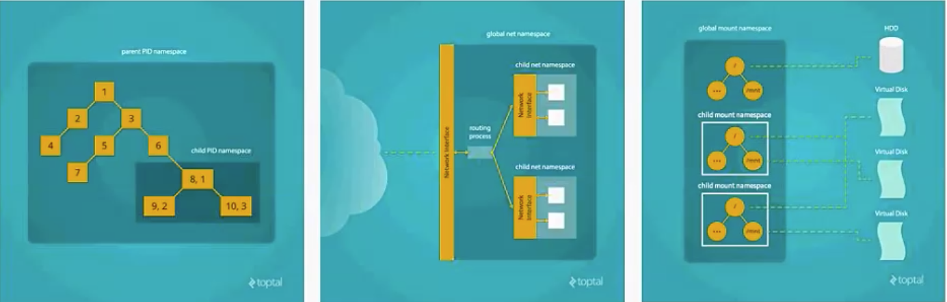
Namespace isolation

Slide 9
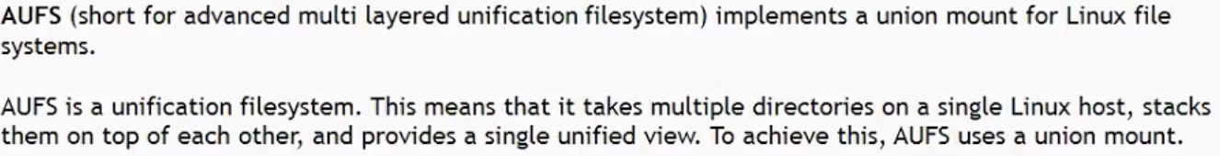
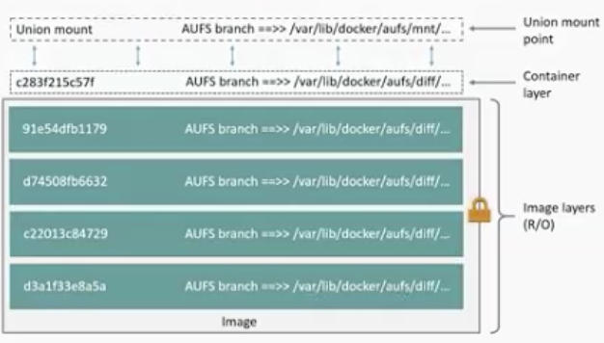
AUFS

Slide 10
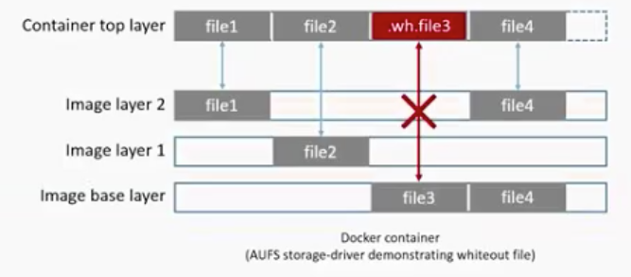
AUFS

Slide 11
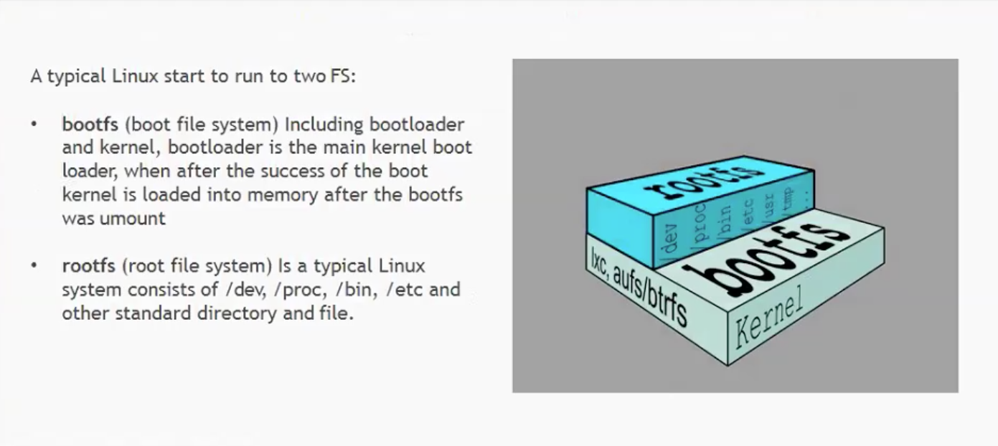
AUFS

Slide 12
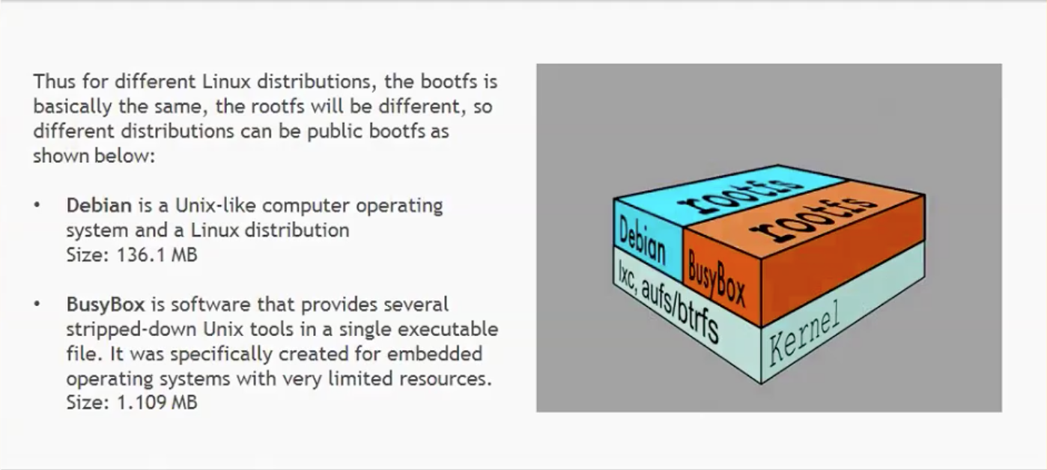
AUFS

Slide 13
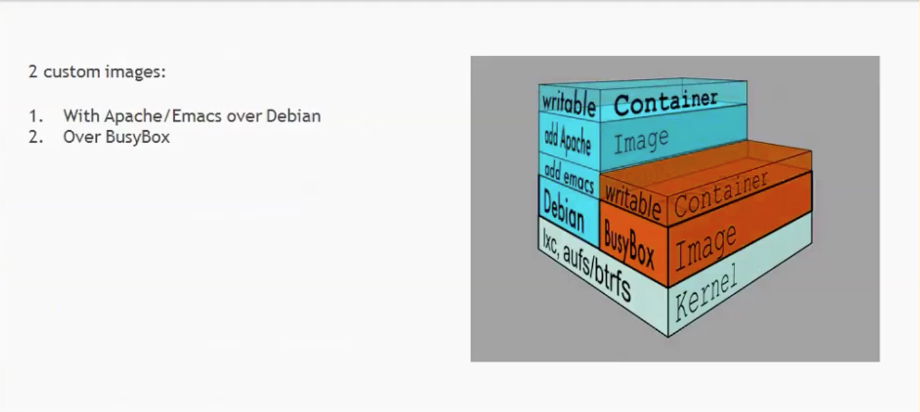
AUFS

Slide 14
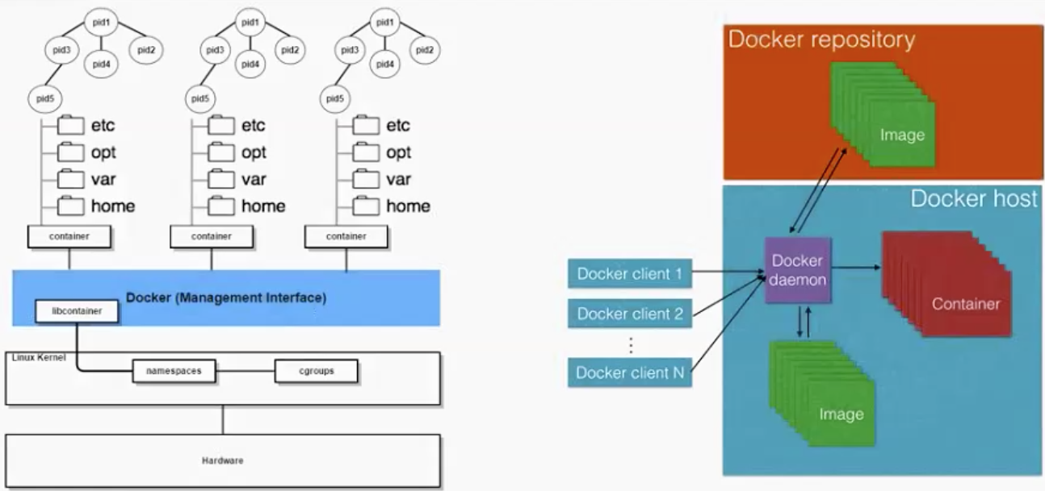
DOCKER UNDER THE HOOD

Slide 15
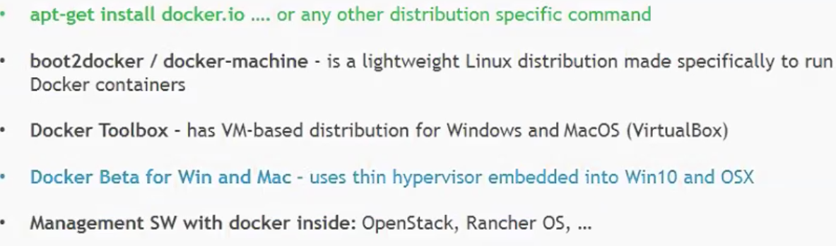
DOCKER STARTUP

